Slide 1
Design of a 16-bit RISC CPU
group one

Slide 2
Architecture
RISC-Reduced Instruction Set Computer
MIPS-Microprocessor Without Interlocked Pipelined Stages
Harvard Architecture
Inspired by Intel 8086 processor

Slide 3
Design implementation
ALU
Register Banks
Control Unit
CPU

Slide 4
Instruction set format
The microprocessor instruction set is divided into 3 main parts
CASE 1: OpCode R1 R2 Immediate Value
/-------\ /-\ /-\ /------------------\
0 0 0 0 0 0 0 0 0 0 0 0 0 0 0 0
CASE 2: OpCode R1 R2 Immediate Value
/-------\ /-\ /-\ /------------------\
0 0 0 0 0 0 0 0 1 1 1 1 1 1 1 1

Slide 5
Instruction set
OPCODE | INSTRUCTION | MEANING
0000 | OR | Or operation
0001 | NOT | Not operation
0010 | AND | And operation
0011 | XOR | Xor operation
0100 | ADD | Addition operation
0101 | SUB | Subtraction operation
0110 | MULT | Multiplication operation
0111 | DIV | Division operation
1000 | MOV | Move operation
1001 | MOV | Move operation
1010 | LOAD | Read from memory
1011 | STORE | Write to memory
1100 | JMPZ | Jump if zero
1101 | JMPN | Jump if negative
1110 | JMPP | Jump if positive
1111 | HALT | Stop the entire CPU

Slide 6
The assembler
The Assembler takes a file as input and generates a hex file ready to run
Avoids programming directly in machine language

Slide 7
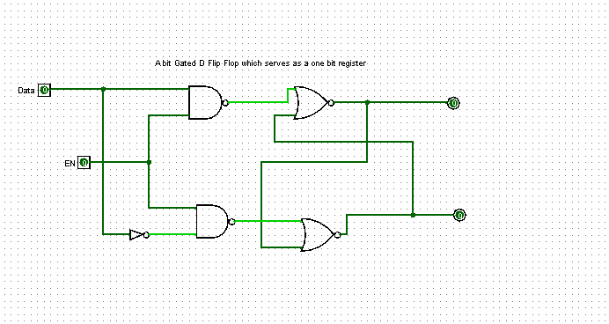
the register a single input data flip flop serving the core of a one bit register

Slide 8
ax-00 bx-01 cx-10 dx-11
REGISTER MNEMONIC IN ASSEMBLY

Slide 9
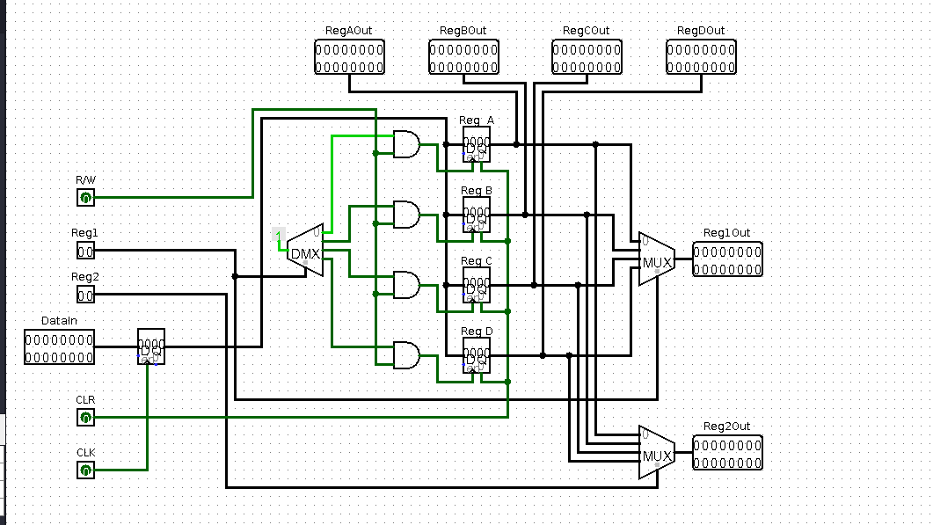
the rigester bank

Slide 10
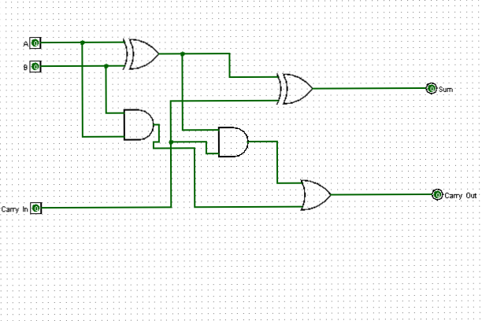
a gated one bit adder

Slide 11
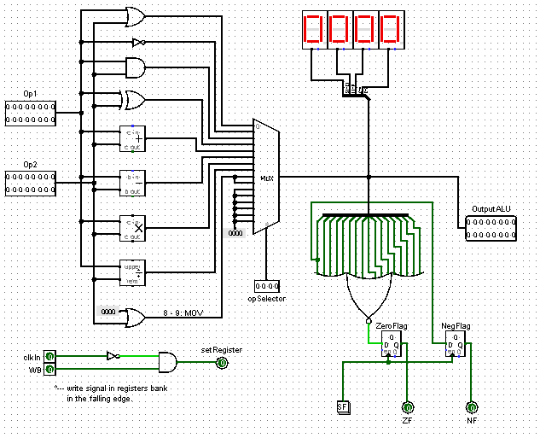
the alu

Slide 12
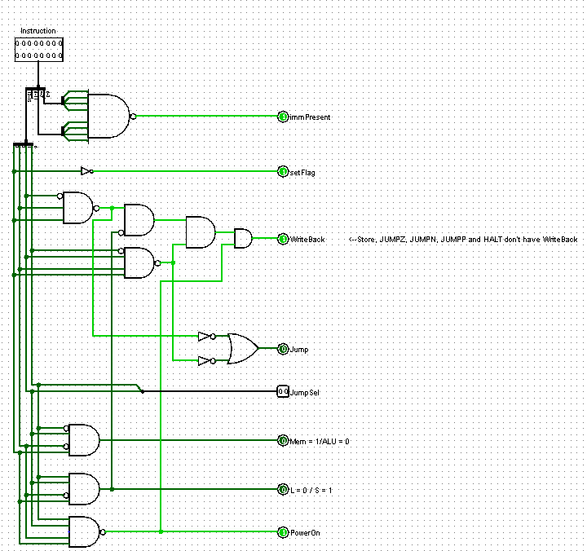
the control unit

Slide 13
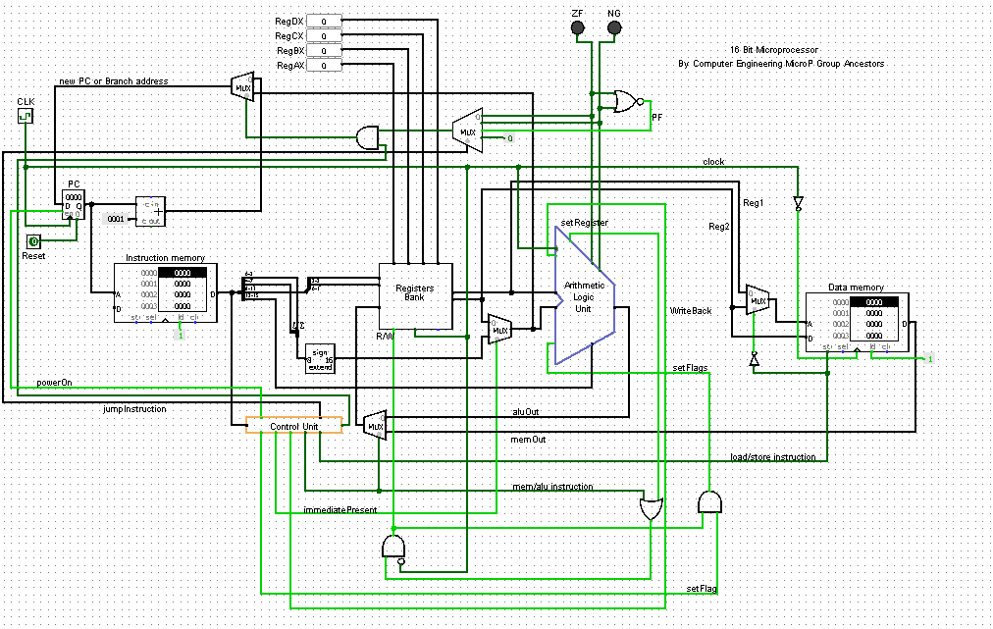
the full microprocessor and how it works

